Slide 1
MAINS RANGE ADJUSTMENT ON DSE 7320 CONTROLLER

Slide 2
Mains range adjustment
Introduction
The main aim of this process is to reduce DG run times/ hours on grid sites.
Grid voltages on sites are usually higher or lower than the set range on our DSE controllers. Because of this Umeme is cut off and the DG is turned on even when the equipment at site can still use the existing voltages.
In this process we aim at standardizing the range set on all our DSE controllers.
The standard ranges Should be;
Lower cut-off limit: 190V
Higher cut-off limit: 255V
This can be done both Manually on the controller or Using DSE configuration suite.
Manually;
-Hold both the stop and enter buttons at the same time, to access the menu.
-Scroll through the menu and enter mains
-Scroll through the mains menu and enter Mains alarms.
-Access low voltage, press the enter button to highlight the value to be changed
set it to 190V

Slide 3
.
-For the high cut off limit, go to over voltage alarm, Enter to highlight the value to be changed. Set it to 255V
-After adjusting the two values, press and hold the enter button (5 seconds) for the configs to be saved.

Slide 4
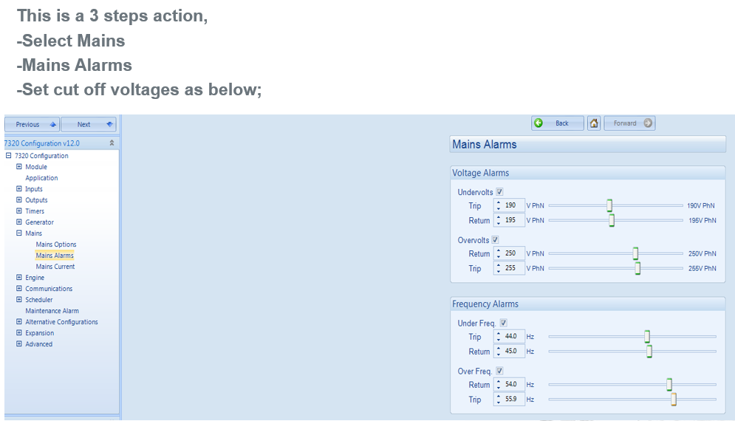
Using dse software
With an updated version of DSE software (latest is 14.1)

